Slide 1

Creating a Subreddit Binary Classifier

Slide 2
Goal
Create binary classifier that:
Takes a ‘title’ as an input
Generates a binary label as an output
Has a mean accuracy of at least 70%

Slide 3


The Subreddits
Activity and Subscribers at 3pm local time

Slide 4
Methodology
Scrape ~1000 data points from each of 2 subreddits
Use data points to create predictive models by:
Vectorizing using TFID
Applying models
Optimizing models using GridSearch
Score all models’ performances on accuracy metric

Slide 5
Models Used
Support Vector Machine Model
Random Forest Model
Logistic Regression Model
Adaptive Boosting Model

Slide 6
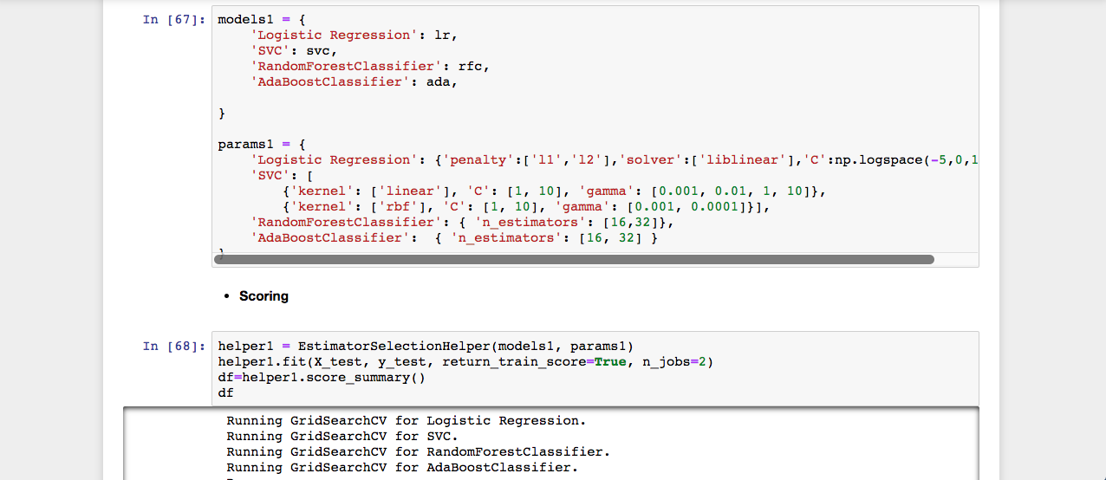
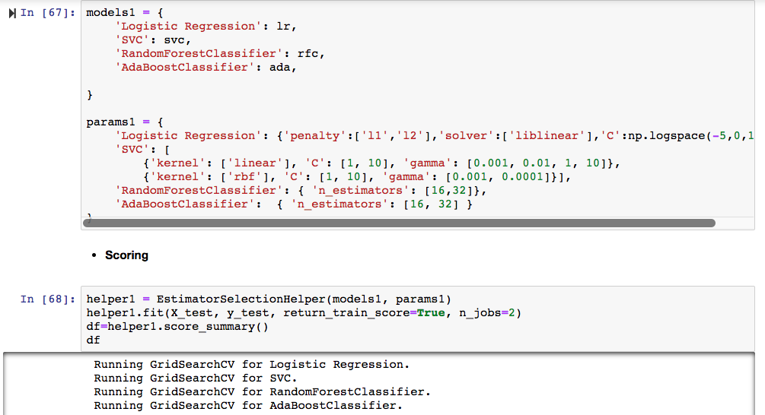
Optimizing Models’ Parameters

Slide 7
Results
Winner: Logistic Regression
Goal Achieved!
Mean Test Accuracy Score = 78%
Logistic regression’s scores after optimizing parameters

